Slide 1
Classification of Nutritional Content for Dietary Recommendations
[AIM-5004-1]
Project By:
Aaron Meoded
Milan Regmi
Syed Ali Hussain
Tharun Prabhakar

Slide 2
Introduction
This project addresses the challenge of dietary recommendation systems with a predictive model that categorizes food items based on comprehensive nutritional profiles.
Data-driven approach to dietary recommendations
Current methods typically rely on oversimplified categorizations.

Slide 3
Pre-Processing and EDA
Pre-Processing:
Handling Missing Values
Feature Scaling
Feature Engineering
Normalization of Data
EDA:
Outlier Treatment
Correlation Analysis
Distribution Analysis

Slide 4
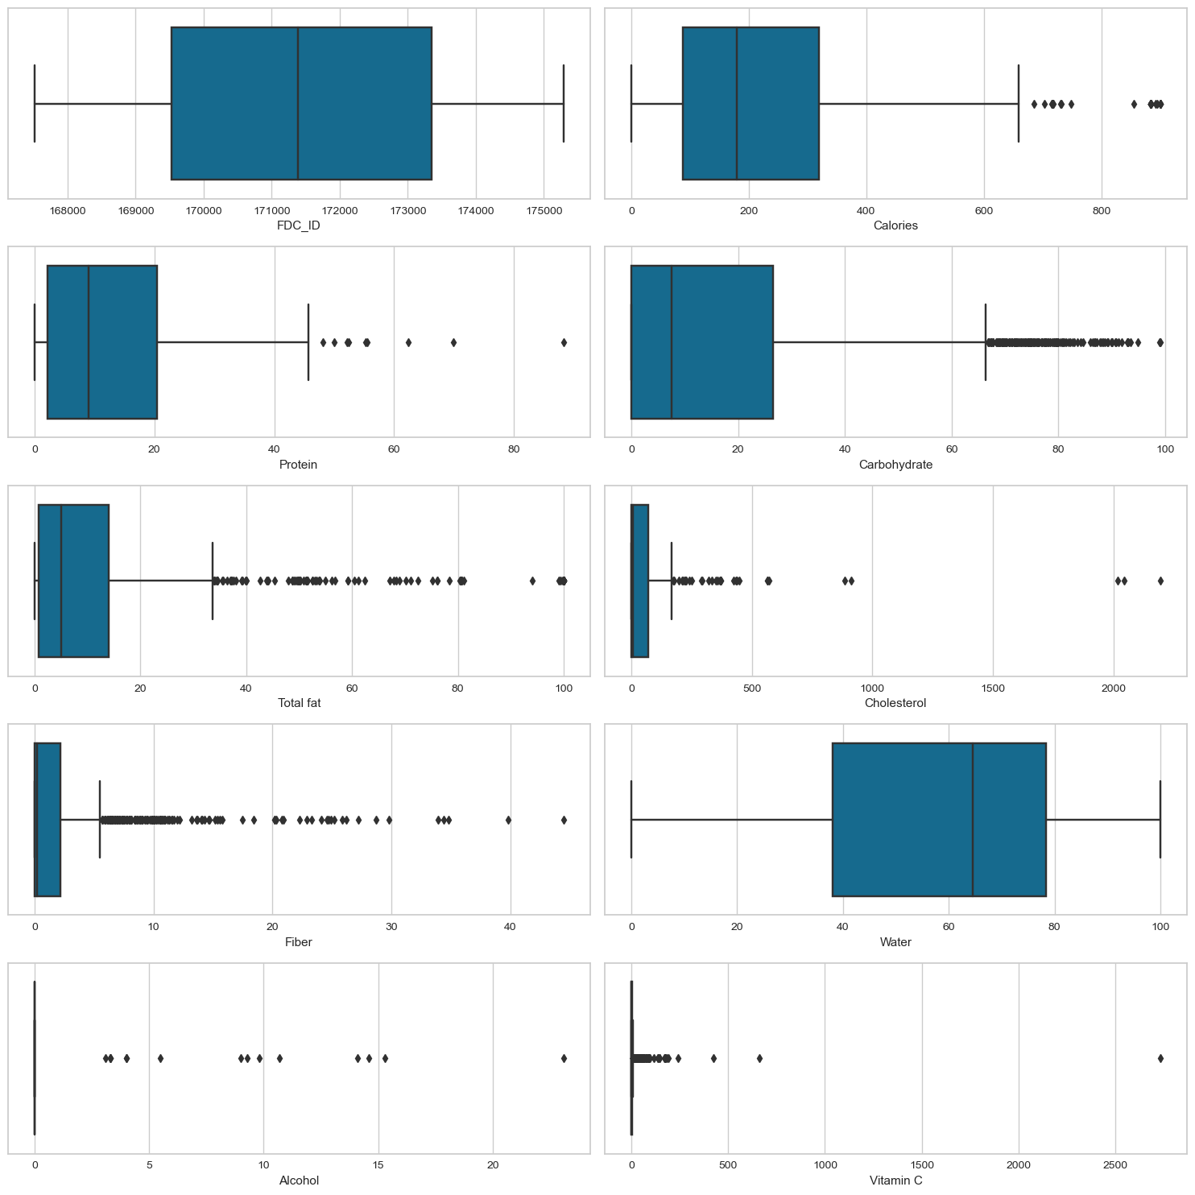
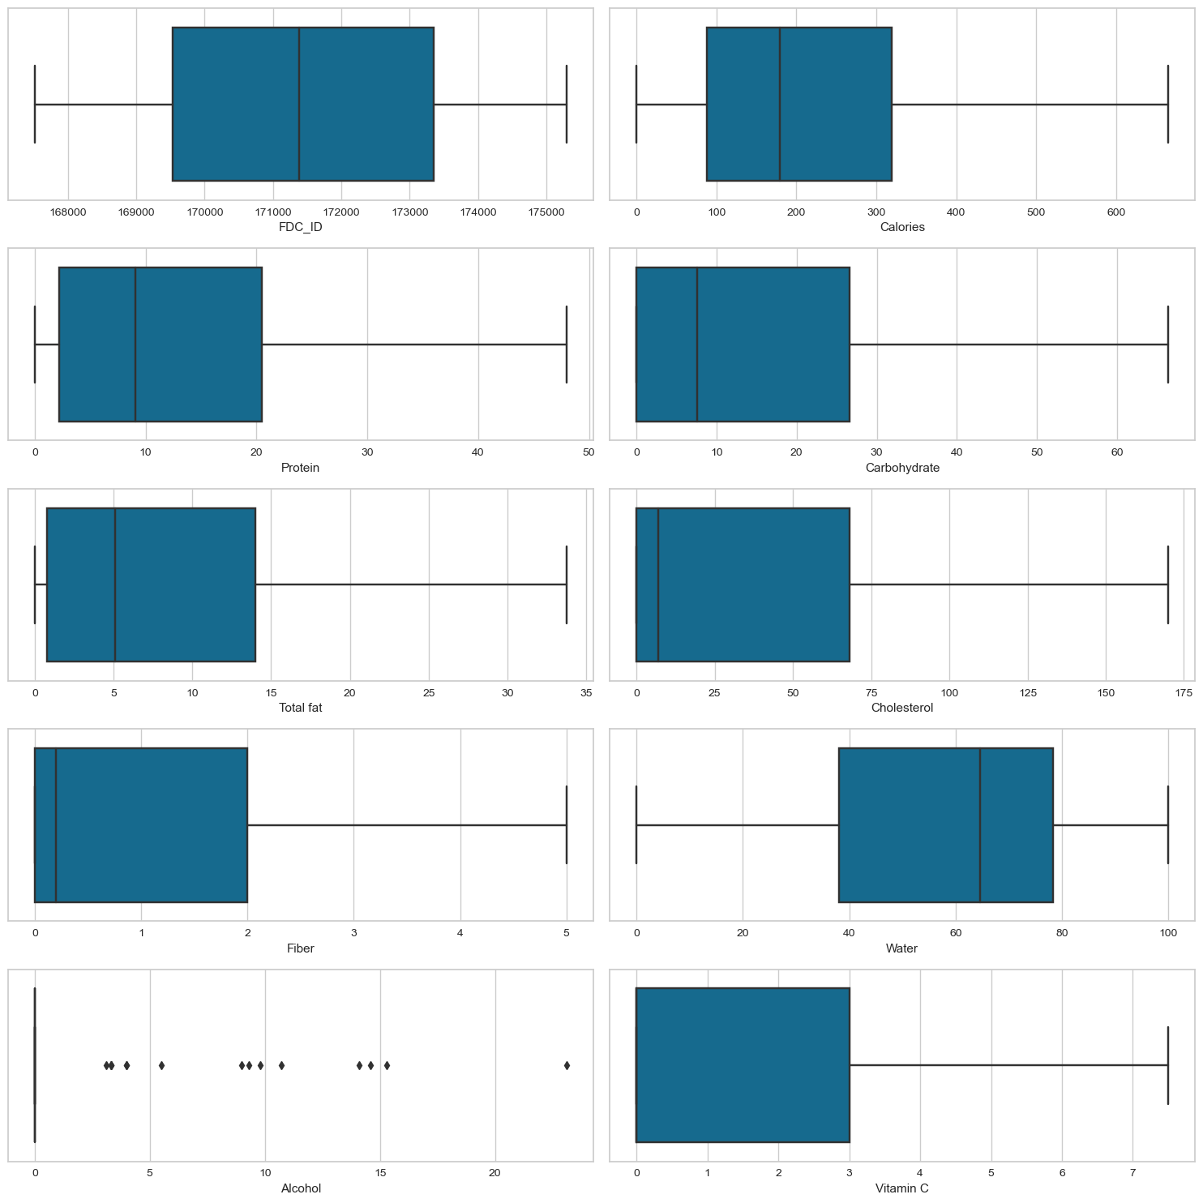
After Outlier Treatment
Before Outlier Treatment

Slide 5
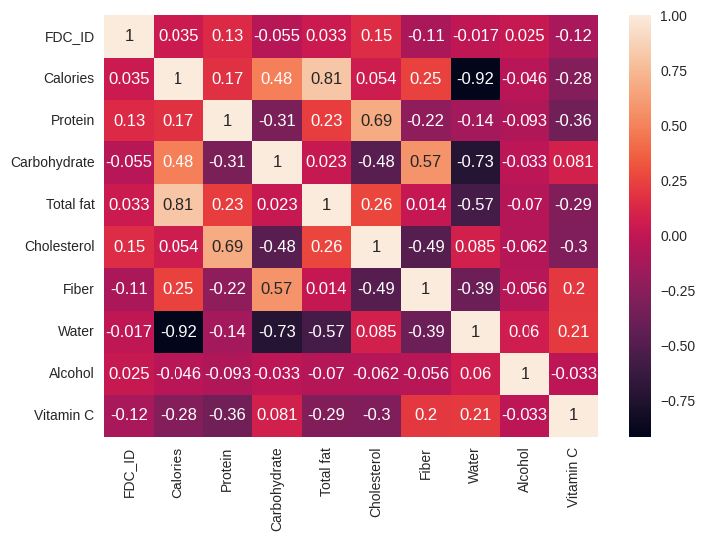
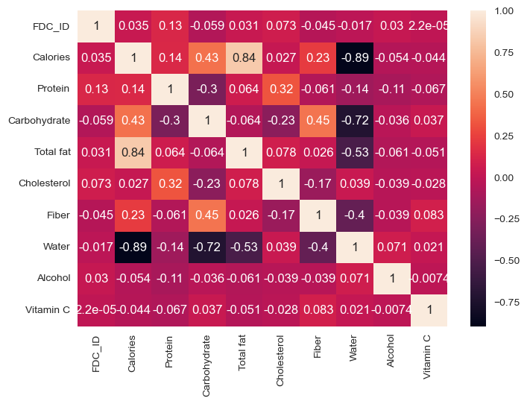
Correlation Analysis
Before Outlier Treatment
After Outlier Treatment(mild relaxation of multi collinearity )

Slide 6
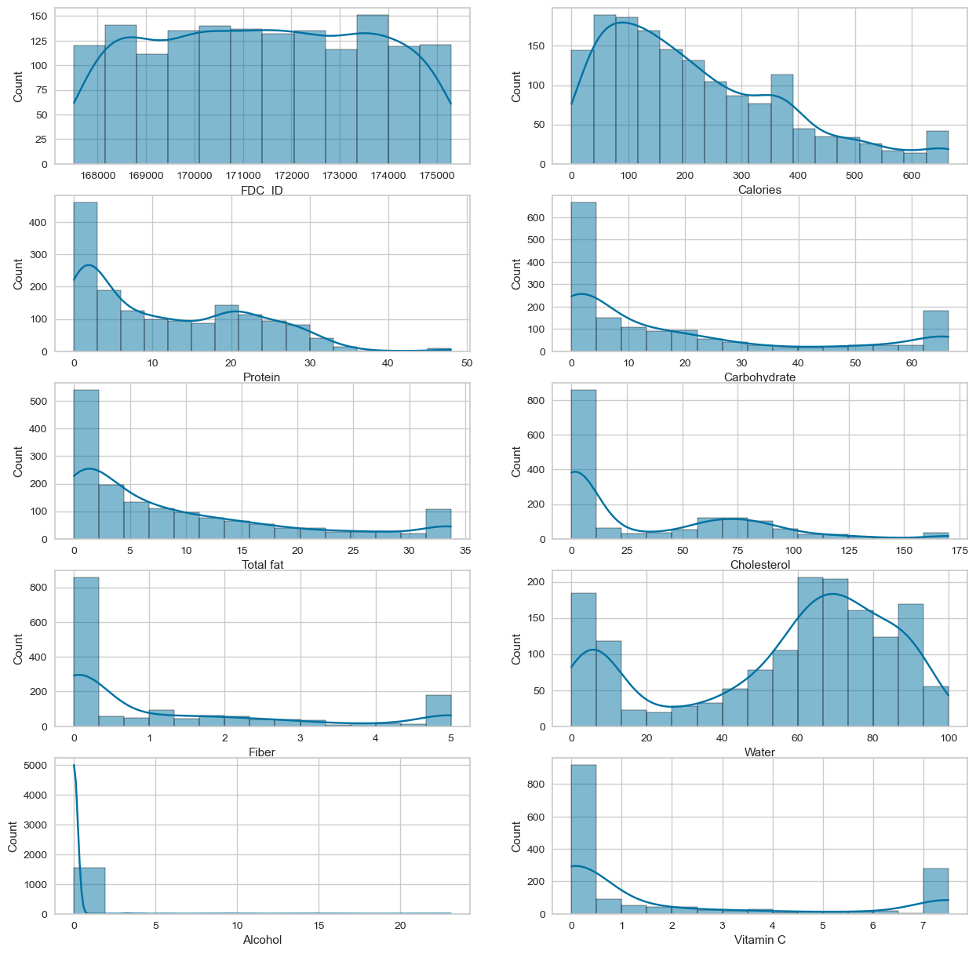
Analysis
Distribution
Histograms for key features to demonstrate the data

Slide 7
Feature Selection + Engineering
”Health_Category”: converted to ordinal, in order of indulgent to most nourishing.
”Category”: converted to ordinal by mapping unique categories to integers in order of occurrence to have a better understanding of the representation of each categories which in turn will help in identification of the trends
Engineered additional features composed of each nutritional column divided by ”Calories”.
Applied MinMaxScaler() to nutritional columns
Attempted to apply NLP model pretrained on BERT to predict label based on ‘Item’, to allow the ‘Item’ column to be meaningful (since it is of string type).

Slide 8
Model Evaluation
Selecting the best model through
trial and error

Slide 9
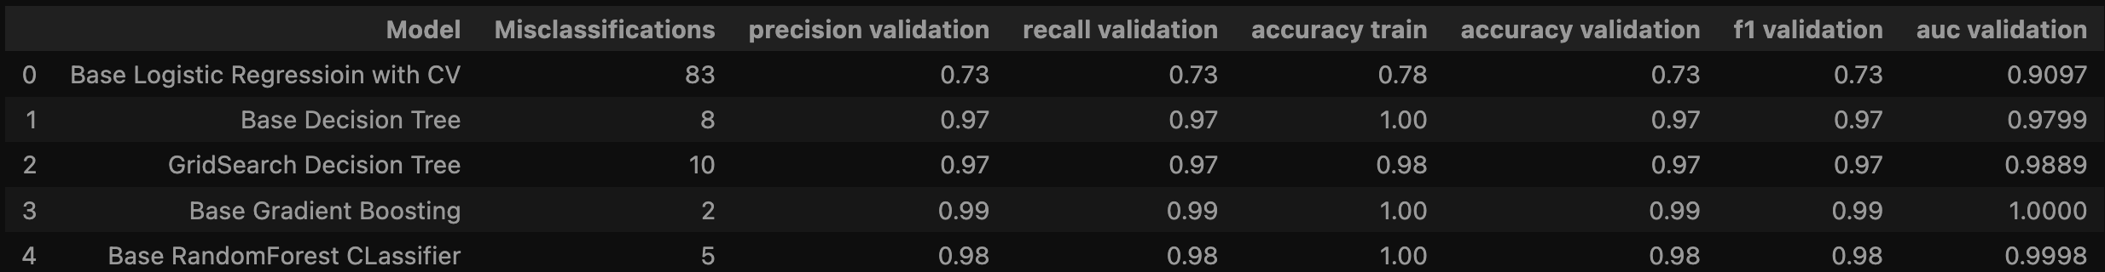
Machine Learning models tried:
Base Decision Tree
Grid Search Decision Tree
Random Forest
Basic Logistic Regression
Gradient Boosting
RESULTS

Slide 10
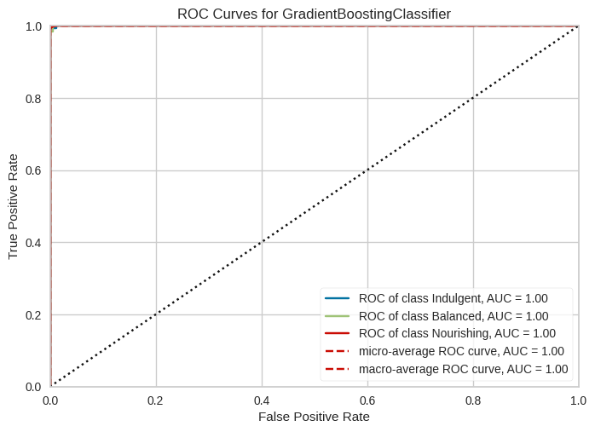
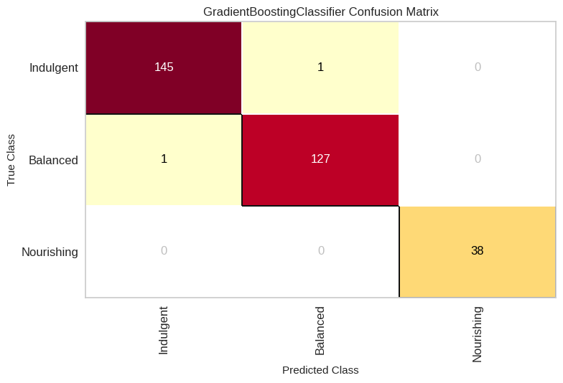
Best Model: gradient Boosting!

Slide 11
Reasons Why GBC Performs Well here
Prevention of Overfitting: The iterative nature of Gradient Boosting, where each new tree corrects errors made by previously trained trees, helps in creating a model that generalizes well to unseen data. This is crucial for the project as it ensures the model performs well not just on the training data but also on the test data
Feature Importance: Gradient Boosting inherently performs feature selection, giving higher importance to features that are more relevant for classification. This capability is beneficial for the project as it automatically identifies and leverages the most informative features from the nutritional data for classification
Optimization of Loss Function: The algorithm's ability to optimize arbitrary loss functions makes it versatile and powerful

Slide 12
Thank you
Questions?

